Slide 1
KEYLOGGER AND SECURITY
Presented By:
Mari Muthu. S- Holy cross engineering college-CSE

Slide 2
OUTLINE
Problem Statement
Proposed System/Solution
System Development Approach
Required libraries and software
Result
Conclusion
Future Scope
References

Slide 3
PROBLEM STATEMENT
Problem statement : In today’s digital age, where cybersecurity threats loom large, one of the significant concerns is the proliferation of keyloggers, stealthy software tools designed to monitor and record keystrokes on a user’s computer without their knowledge.Keyloggers pose a severe threat to individuals and organizations as they can capture sensitive information such as passwords,credit card details,and other personal data,leading to identify theft,financial loss,and privacy breaches.

Slide 4
PROPOSED SOLUTION
The proposed system aims to address the challenge of keylogger security system. This involves requirement analysis ,. The solution will consist of the following components:
Requirement analysis:
The timing of the email and the email address can be changed later in the settings.
The daily report will be mailed to the PC owner on his/her email.
Keyboard monitoring:
Python 3 library pynput is used for on screen keyboard.
These keystrokes saved in text file will be maintained for 7 days.
Maintaing the log file :
The keylogger will maintain the files containing the keystrokes for a maximum of 7 days.
The program will then automatically delete the past files.
This settings can also be changed later.
Prevention:
Antivirus
Automatic form fillers
On screen Keyboard

Slide 5
SYSTEM APPROACH
The "System Approach" section outlines the overall strategy and methodology for developing and implementing the keylogger and security system. Here's a suggested structure for this section:
System requirements
Library required to build the model

Slide 6
REQUIRED LIBRARIES & SOFTWARE
python idle
pip install pynput
pip install jsonlib

Slide 7
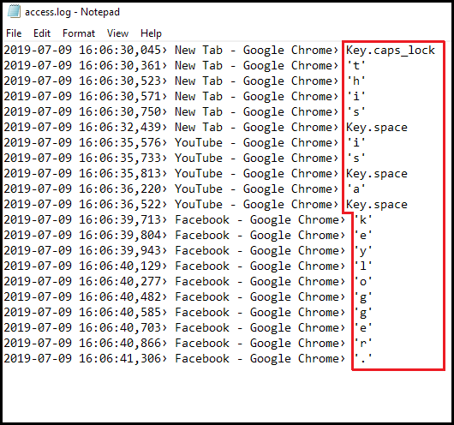
RESULT
Attack tactics and social engineering are
some of the common ways keyloggers are installed in
a malicious scenario. But there is another way this
software can find its way to your computer. Imagine a
scenario where you make your way to a file-sharing site
or software marketplace and choose a software download.
While doing so, you get something extra – your software
comes bundled with a keylogger. This way, a keylogger
can infiltrate your "safe" computer.

Slide 8
CONCLUSION
Keyloggers are a potent threat to both individuals and enterprises ,with the potential to cause significant harm if left undetected . Understanding the nature of keyloggers , their methods of infiltration , and the dangers they pose is crucial for maintaining a secure digital environment.

Slide 9
FUTURE SCOPE
The development of more advanced encryption methods to protect against keyloggers.Additionally,there could be advancements in behavioral analysis techniques to detect and prevent keylogging attempts . Some potential areas of focus include developing machine learning algorithms to detect unusual typing patterns ,enhancing real-time monitoring systems, and improving user education about the risks and prevention of keyloggers.

Slide 10
REFERENCES
REFERENCES [1] Working of Keyloggers available at http://securelist.com/analysis/publications/36138/keyloggers-how-theywork-and-how-todetect-them-part-1. [2] C.a.Rajendra.”Keylogger in Cybersecurity Education”. Rechester Institute of Technology,Rechester,New York,USA. [3] M. Aslam, R. N. Idrees, M. M. Baig, and M. A.Arshad, “Antihook shield against the software key loggers,” in Proceedings of the National Conference of Emerging Technologies,2004. [4] E. S. L. Martignoni, M. Fredrikson, S. Jha, and J. C. Mitchell, "A layered architecture for detecting malicious behaviors,”.Heidelberg.2008 [5] C. Y. D. Le, T. Smart, and H. Wang,, "Detecting kernel level keyloggers through dynamic taint analysis," College of William & Mary, Department of Computer Science, illiamsburg,,2008. [6] C. G. S.Ortani, and Crispo.”Bait your Hook: A novel Detection technique for keylogger”. University of Trento, Via Sommarive.Trento, Italy.2010. [7] S.S.a.Anith.

Slide 11
THANK YOU

